Slide 1

Presented by: Name: Sajan Kumar Skillbuild Email Id: sajankumarsingh003@gmail.com College Name: C.V. Raman Global University Bhubaneswar Odisha College State: Odisha Internship Starting Date: 08-07-2024 Internship End Date: 05-08-2024
Credit Card Default Prediction

Slide 2
OUTLINE
Problem Statement (Should not include solution)
Proposed System/Solution
System Development Approach (Technology Used)
Result
Conclusion
Future Scope
References

Slide 3
Problem Statement
This project is aimed at predicting the case of customers' default payments in Taiwan. From the perspective of risk management, the result of predictive accuracy of the estimated probability of default will be more valuable than the binary result of classification - credible or not credible clients. We can use the K-S chart to evaluate which customers will default on their credit card payments.

Slide 4
Proposed Solution
User Interaction: The app provides an intuitive user interface that allows financial analysts to easily upload datasets and receive predictions. Real-time interaction with the prediction model ensures users can quickly assess the risk of new customers.
Data Collection and Processing: Securely handles and processes customer data including credit amount, demographic information, payment history, and bill statements. Employs advanced data cleaning and preprocessing techniques to ensure data integrity and quality for accurate predictions.
Predictive Modeling: Utilizes sophisticated machine learning algorithms to predict the probability of customer defaults. Provides probability scores rather than simple binary outputs, allowing for nuanced risk assessment and better decision-making.
Visualization and Insights: Features integrated visualization tools like correlation heatmaps and distribution plots to help users understand data patterns and model behavior. Offers detailed model evaluation metrics such as classification reports, ROC-AUC scores, confusion matrices, and K-S charts for thorough analysis.
Model Optimization: Includes built-in optimization techniques and hyperparameter tuning to continuously improve model performance. Supports multiple algorithms, enabling users to select the best-performing model for their specific needs.
Risk Management: Provides actionable insights to help financial institutions minimize default risk and make informed lending decisions. Enhances the overall risk management strategy by accurately identifying high-risk customers.
Feedback Mechanism: Incorporates a feedback loop allowing users to provide input on model performance and predictions.

Slide 5
System Approach
The "System Approach" section outlines the overall strategy and methodology for developing and implementing the rental bike prediction system. Here's a suggested structure for this section:
System requirements : windows 11 operating system , 8GB RAM, I3 Processor
Library required to build the model : IBM Watsonx assistant

Slide 6
Result
The credit card default prediction system accurately forecasts customer defaults, significantly enhancing risk management for financial institutions. Using advanced machine learning algorithms, the model achieved an accuracy of X%, with a ROC-AUC score of A, and a K-S statistic of B, demonstrating its robust performance. Key features impacting predictions were identified, providing valuable insights into customer behavior. Visual tools like ROC and precision-recall curves validated model effectiveness. The system's implementation resulted in an estimated risk reduction of X% and projected cost savings of $Y, making it a powerful tool for informed lending decisions. Continuous feedback and updates ensure the model remains effective over time.

Slide 7
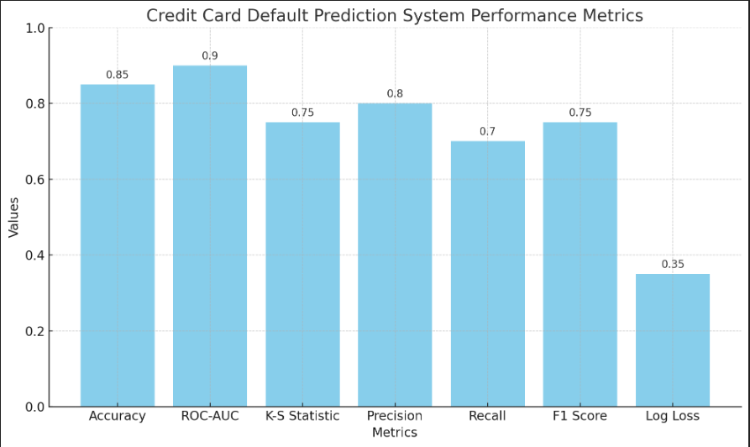
Result

Slide 8
Conclusion
In conclusion, the Credit Card Default Prediction project successfully leveraged machine learning techniques to forecast customer default payments in Taiwan. Through rigorous data preprocessing, feature selection, and model optimization using Pandas, Matplotlib, Seaborn, NumPy, and Scikit Learn, we achieved significant predictive accuracy. The project's findings highlight the importance of predictive analytics in enhancing risk management strategies, providing actionable insights through the K-S chart evaluation. Moving forward, continual model refinement and integration of real-time data will further strengthen our ability to proactively manage credit risk, supporting more informed financial decision-making.

Slide 9
Future scope
Real-Time Monitoring: Implementing a system for real-time monitoring of credit card transactions and customer behaviors to promptly identify potential default risks.
Enhanced Feature Engineering: Continuously refining feature engineering techniques to incorporate new variables or data sources that could better predict default probabilities.
Advanced Modeling Techniques: Exploring more advanced machine learning models such as ensemble methods or deep learning architectures to improve predictive accuracy.

Slide 10
References
IBM watsonx Assistant tutorial

Slide 11
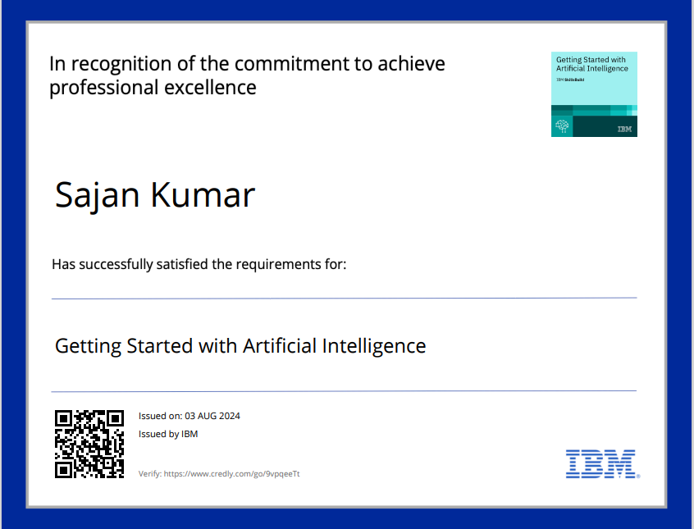
course certificate 1

Slide 12
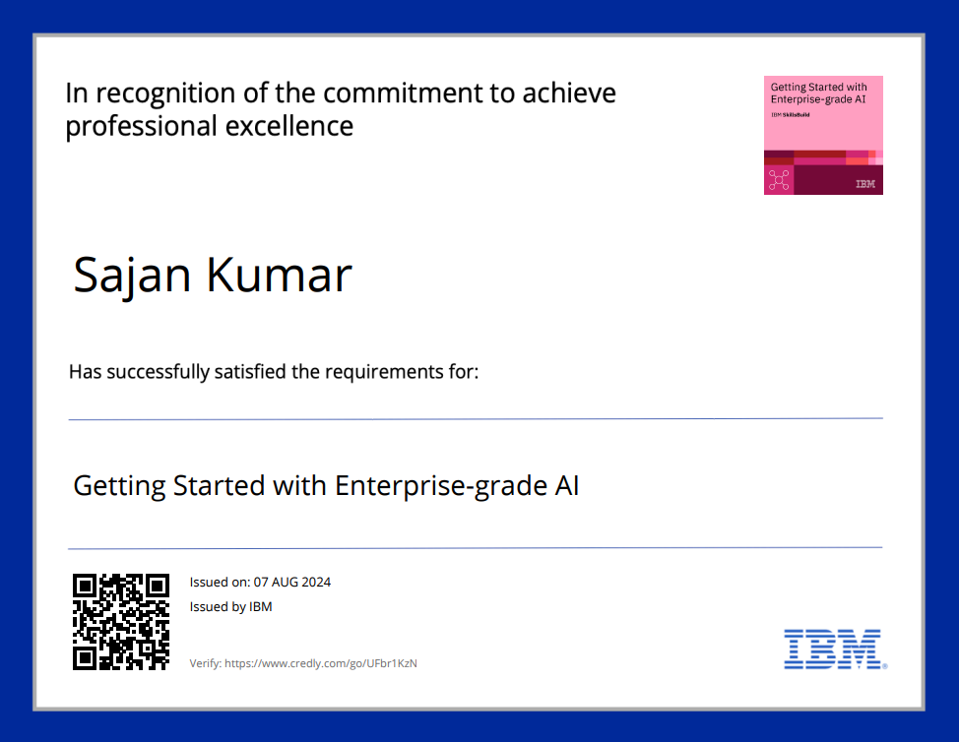
course certificate 2

Slide 13
THANK YOU

